Slide 1

Course : Human - Computer Interaction
Year : 2023
INTERACTION DESIGN
SESSION 01

Slide 2
LEARNING OUTCOMES
• LO 1: Describe the concept of interaction
design

Slide 3
Due: Week 7
Deliverable
You will submit a brief writeup that describes both UIs. For each UI provide:
- a photograph or screenshot,
- a description of what the interface is for (1-2 sentences),
- a justification for why it belongs in the "Hall of fame/shame' (3-4 concise bullets referring to design principles)
Submit a single pdf in Binusmaya. Be sure to include your name in the submitted file.

Slide 4

Assignment 1
The goal of this assignment is to identify and critique good and bad user interfaces. Find an example of both a Hall of Fame UI and a Hall of Shame UI. Justify your choices with design and usability principles that were covered in class or that you learned elsewhere; e.g. Nielsen's heuristics, The UI can be for anything that involves human interactions to perform a task; from webpages, apps, kiosks to appliance controls, gadgets, or toys.
Week
Deliverable
You will submit a brief writeup that describes both UIs. For each UI provide:
- a photograph or screenshot,
- a description of what the interface is for (1-2 sentences),
- a justification for why it belongs in the "Hall of fame/shame' (3-4 concise bullets referring to design principles)
Submit a single pdf in Binusmaya. Be sure to include your name in the submitted file.

Slide 5



Assignment 2: FINAL QUIZ
Week

Slide 6
LEARNING PLAN
Session | Topic | Assignment | Description
1 | Interaction Design | TA1 | Team Project Assignment #1 : Find a Team, Find a Project (3 weeks)
2 | Understanding and Conceptualizing Interaction | TA1
3 | Cognitive Aspects | TA1 | Revision Project (2 Weeks)
4 | Social Interaction | TA1.1
5 | Emotional Interaction | TA2 | Team Project Assignment #2 : Data Gathering (1 week)
6 | Interfaces | TA3 | Team Project Assignment #3 : User & Task Analysis (1 week)
7 | Review I | TA4 | Team Project Assignment #4 : Activity Design & Low Fidelity Prototyping (2 week)
8 | Discovering Requirements | TA4
9 | Data Analysis, Interpretation, and Presentation | TA5 | Team Project Assignment #5 : High Fidelity Prototyping (2 week)
10 | Design , Prototyping and Construction | TA5
11 | Introducing Evaluation | TA6 | Team Project Assignment #6 : Evaluation & Prototype Revision #1 (1 weeks)
12 | Advanced Evaluation | TA7 | Team Project Assignment #7 : User Testing & Prototype Revision #2 (1 week)
13 | Review II | TA8 | Team Project Assignment #8 : Presentation & Final Report

Slide 7
LEARNING PLAN
The heart of this course is a semester-long project, in which you will design, implement, and evaluate a user interface. User interface design is an iterative process, so students will build UI not just once, but four times, as successively higher-fidelity and more complete prototypes. In order to have time for these iterations, we need to get started on the project as early as possible.
Group project will involve create the design of a Website or Mobile application interface with a topic guide from a lecturer.
Project teams may consist of 3-5 people. Teams will primarily be formed based on the results on the first brainstorming exercise and in-class discussion.
The results of your project should be implemented up to High Fidelity prototyping. You are free to use any means to create high fidelity prototyping, but must be able to run on a variety of PC/Mobiles.

Slide 8
OUTLINE
^{Introduction}
^{Good and Poor Design}
^{What is Interaction Design ?}
^{The User Experience}
Usability and User Experience Goals
What is involved in Interaction Design

Slide 9
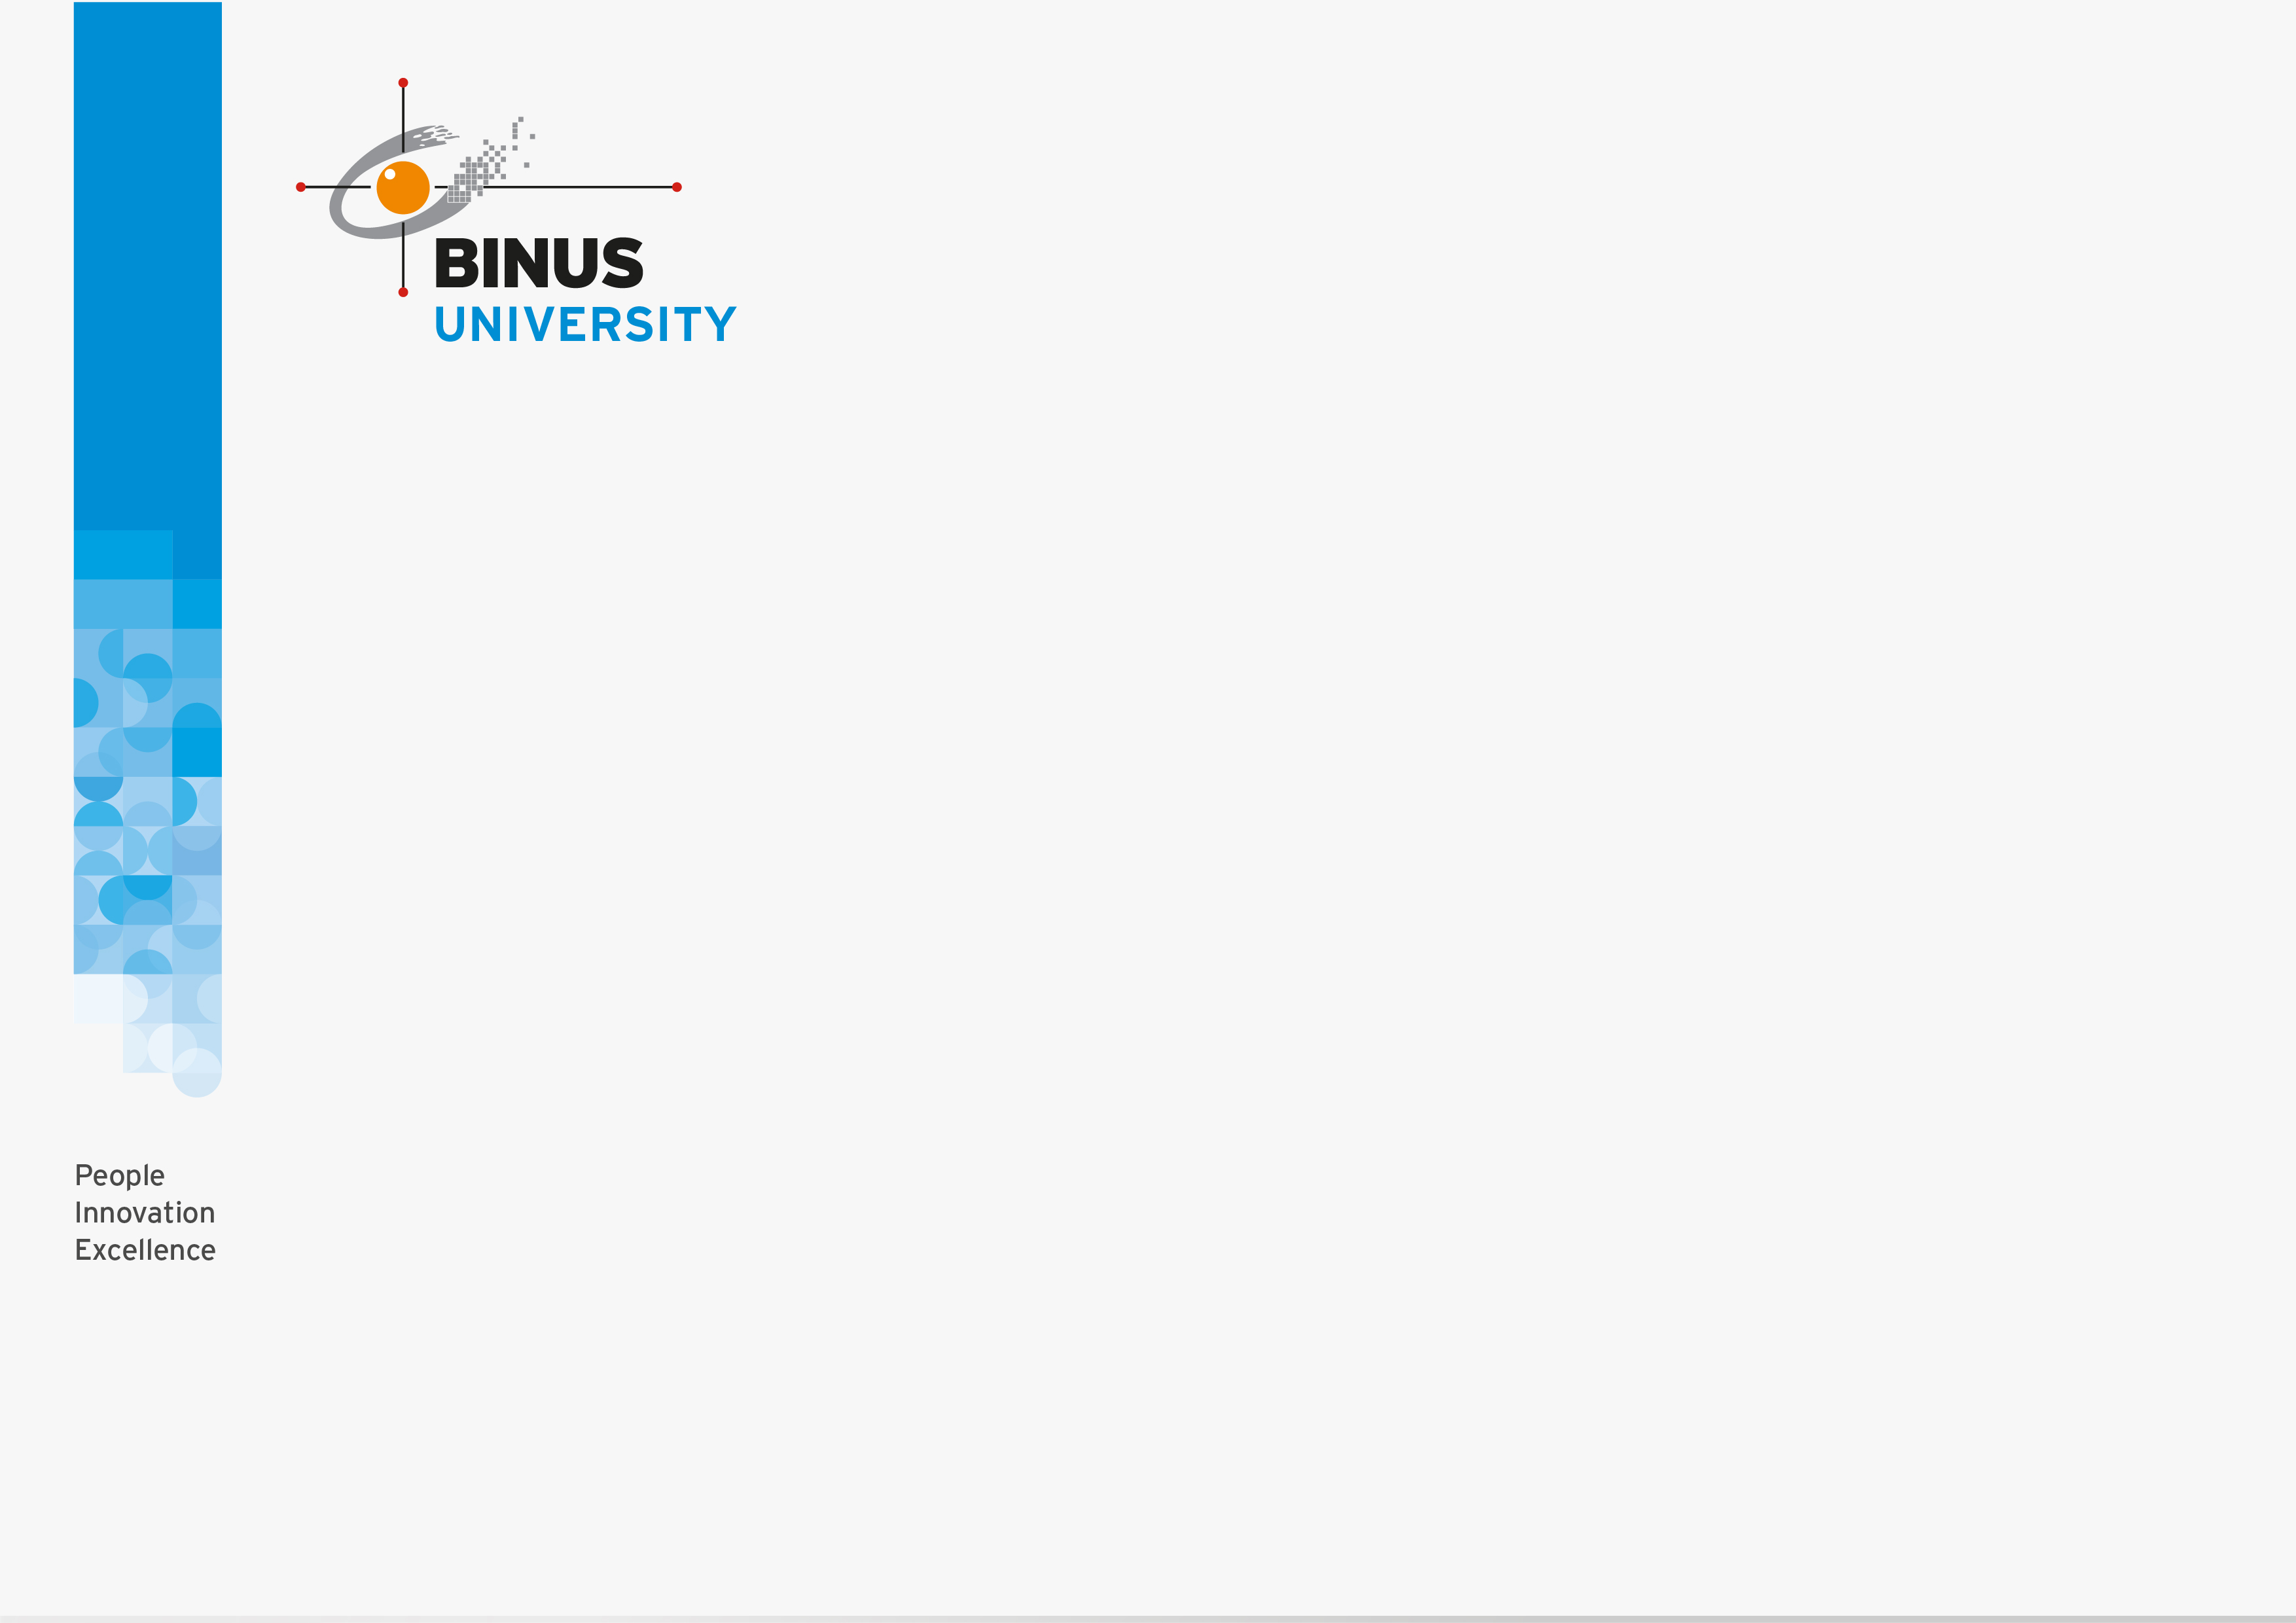
INTRODUCTION
How many interactive products are there in everyday use ?
Now think how useable they are ?
How many are actually easy, effortless, and enjoyable to use ?
Many products that require users to interact with such as Smartphone and social networking sites, have been designed primarily with the user in mind. They are generally easy and enjoyable to use.

Slide 10
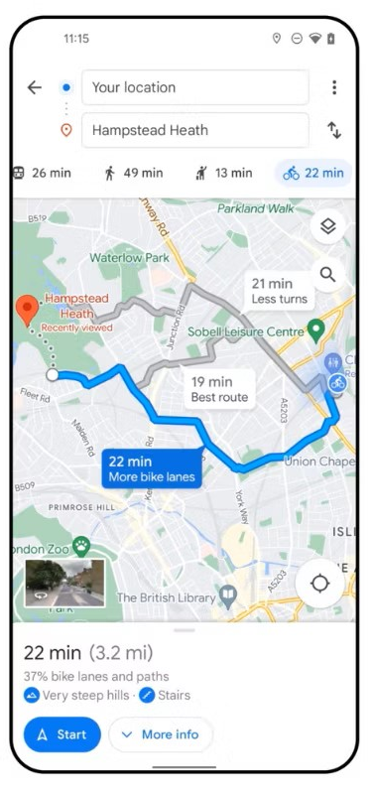




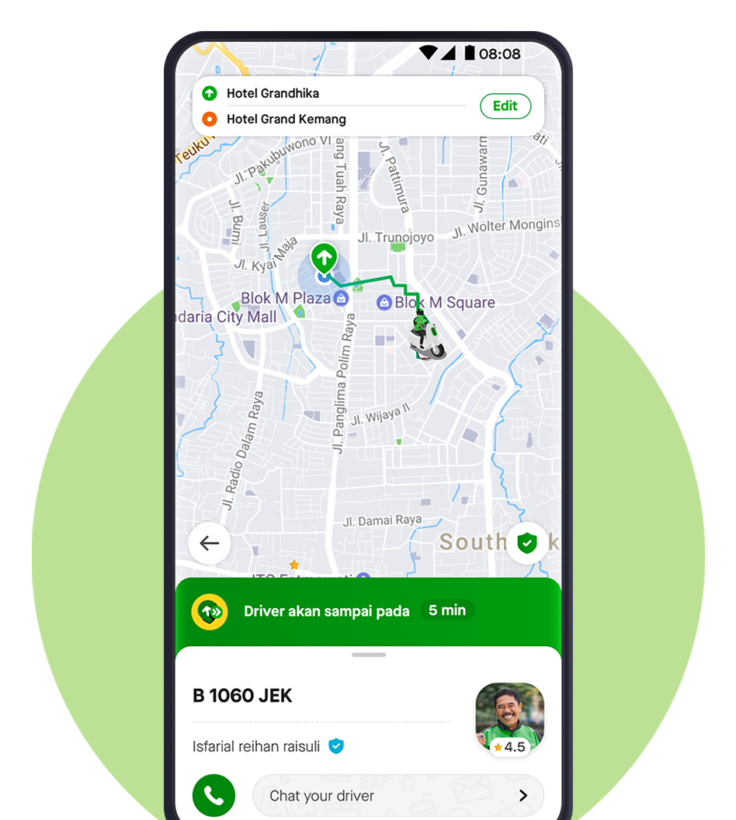
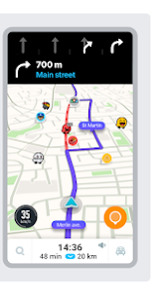

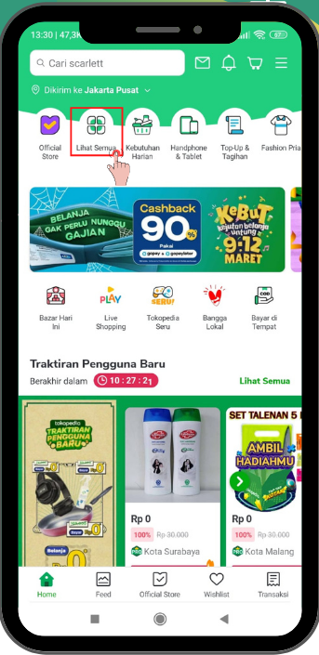
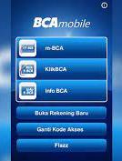

Slide 11
INTRODUCTION
Others have not necessarily been designed with the users in mind. Rather, they have been engineered primarily as software systems to perform set functions. An example is setting the time on a stove that requires a combination of button presses that are not obvious as to which ones to press together or separately..
One main aim of interaction design is to reduce the negative aspects (e.g. frustration, annoyance) of the user experience while enhancing the positive ones (e.g. enjoyment, engagement).

Slide 12
GOOD AND POOR DESIGN
A central concern of interaction design is to develop interactive products that are usable. By that's mean product that are generally easy to learn, effective to use and provide an enjoyable user experience.
A good place to start thinking about how to design usable interactive products is to compare examples of well-designed and poorly designed ones.
Through identifying the specific weaknesses and strengths of different interactive products, can begin to understand what it means for something to be usable or not.
Here the examples of poorly designed products : a voice mail system used in hotels, and the ubiquitous remote control device.

Slide 13
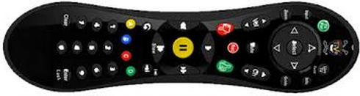
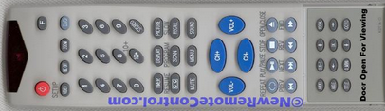
GOOD AND POOR DESIGN
When considering the design of an integrative product , it is important to take into account where it is going to be used and who is going to use it.
Remote Control Device ( The Tivo Remote vs Standard Remote) (See Fig. 01.01(a)&(b))
Every home entertainment system, such as TV, Music System, DVD Player, comes with its own remote control device. Each one is different in terms of how it looks and works.
Figure 01.01 (a) The Tivo Remote
Figure 01.01(b) Standard Remote

Slide 14
GOOD AND POOR DESIGN
(a) TiVo Remote
The buttons are large
Cleary labeled
Logically arranged
Making them easy to locate and use in conjunction with the menu interface that appears on the TV monitor.
It has a playful look and feel about it
Colorful buttons and cartoon icons have been used that are very distinctive, making it easy to identify them in the dark and without having to put reading glasses on.

Slide 15
GOOD AND POOR DESIGN
(b) Standard Remote
Many viewers especially when sitting in their living room , find it difficult to locate the right ones, even for the simplest of tasks, like pausing or finding the main menu.
Need to put their reading glasses each time to read the buttons. It can be frustrating.
The remote control device appears to have been put together very much as an afterthought.

Slide 16

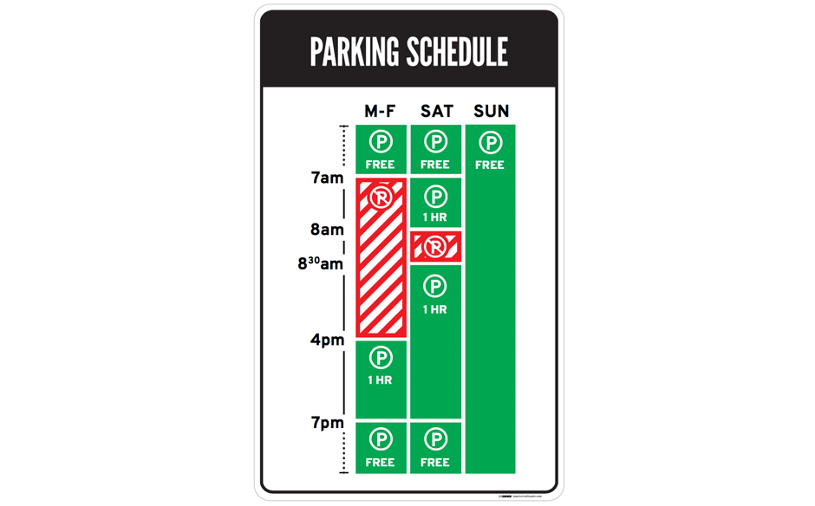
EXAMPLE GOOD AND POOR DESIGN (Your Turn)
A
B
  Parking Sign
  Based on the image above, which one the best interaction design? Please explain!

Slide 17
WHAT IS INTERACTION DESIGN
Interaction Design :
  Designing interactive products to support the way people communicate and interact in their everyday and working lives.
Interaction design is generally used as the overarching term to describe the field, including its methods, theories, and approaches. UX is used more widely in industry to refer to the profession. However, the terms can be used interchangeably. Also, it depends on their ethos and brand.

Slide 18
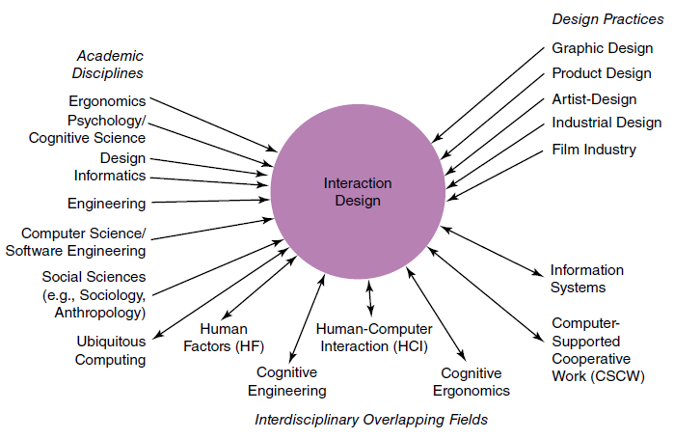
WHAT IS INTERACTION DESIGN
Relationship among contributing academic disciplines, design practices, and interdisciplinary fields concerned with interaction design (double arrow means overlapping) ( See Figure 01.02).
Figure 01.02 Relation Interaction Design with other academic disciplines

Slide 19
WHAT IS INTERACTION DESIGN
Who is involved in Interaction Design
a. Designers :
  need to know many different things about users, technology, and interaction between them in order to create effective user experiences.
  need to understand how people act and react to events and how they communicate and interact with each other.
  need to understand how emotions work, what is meant by aesthetics, desirability, and the role of narrative in human experience.
  b. Developers
  Need to understand the business side, the technical side, the manufacturing side, and the marketing side.

Slide 20
WHAT IS INTERACTION DESIGN
Who is involved in Interaction Design ( continue)
  Multidisciplinary teams where the skill sets of engineers, designers, programmers, psychologist, anthologists, sociologists, artists, toy makers, and others.
  Who to include in a team will depend on a number of factors, including a company’s design philosophy, its size, purpose, and product line.

Slide 21
WHAT IS INTERACTION DESIGN
The process of interaction design involves four basic activities :
  Establishing requirements
  Designing alternatives
  Prototyping
  Evaluating
These activities are intended to inform one another and to be repeated .
Evaluating what has been built is very much at the heart of interaction design. Its focus is on ensuring that the product is appropriate.

Slide 22
THE USER EXPERIENCE
The user experience refers to how a product behaves and is used by people in the real world.
More specifically, it is about how people feel about a product and their pleasure and satisfaction when using it, looking at it, holding it, and opening or closing it.
It includes their overall impression of how good it is to use, right down to the sensual effect small details have on them, such as how smoothly a switch rotates or the sound of a click and the touch of a button when pressing it

Slide 23
USABILITY AND USER EXPERIENCE GOALS
Usability Goals
The following goals :
  Effective to use ( effectiveness)
  Efficient to use ( efficiency)
  safe to use ( safety)
  having good utility ( utility)
  easy to learn ( learnability)
  easy to remember how to use ( memorability)
User Experience Goals
  A diversity of user experience goals has been articulated in interaction design, which cover a range of emotions and felt experiences. ( See table 1)

Slide 24
USABILITY AND USER EXPERIENCE GOALS
Table 1 Aspects of the User Experience
Desirable Aspects
Satisfying | Helpful | Fun
Enjoyable | Motivating | Provocative
Engaging | Challenging | Surprising
Pleasurable | Enhancing Sociability | Rewarding
Exciting | Supporting creativity | Emotionally fulfilling
Entertaining | Cognitively stimulating
Undesirable Aspects
Boring | Annoying | Patronizing
Frustrating | Childish | Making one feel stupid
Making one feel guilty | unpleasant | Cutesy
Gimmicky

Slide 25
USABILITY AND USER EXPERIENCE GOALS
They differ from the more objective usability goals in that they are concerned with how users experience an interactive product from their perspective, rather than assessing how useful or productive a system is from its own perspective.
Recognizing and understanding the nature of the relationship between usability and other user experience goals is central to interaction design.

Slide 26
USABILITY AND USER EXPERIENCE GOALS
Design principles are used by interaction designers to aid their thinking when designing for the user experience.
Here the most common ones of design principles :
  Visibility
  Feedback
  Constraint
  Consistency
  Affordance

Slide 27
WHAT IS INVOLVED IN INTERACTION DESIGN
Interaction Design
Interaction design has specific activities focused on discovering requirements for the product, designing something to fulfill those requirements, and producing prototypes that are then evaluated. In addition, interaction design focuses attention on users and their goals.
Interaction design have 4 phases as follows:
  Discover – Insight into the problem
  Define – Develop a clear brief that frames the design challenge
  Develop – Solutions or concepts are created, prototyped, tested and iterated.
  Deliver – The resulting project is finalized, produced and launched.

Slide 28
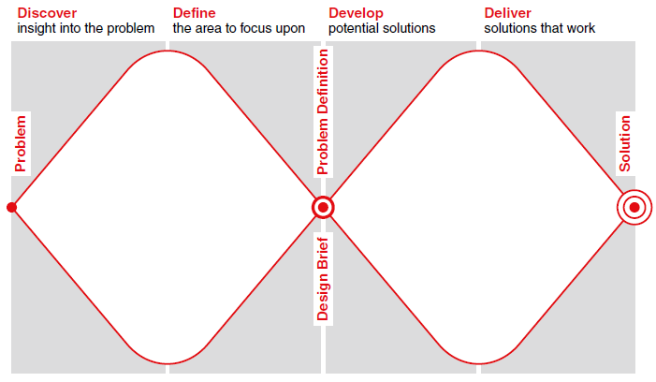
WHAT IS INVOLVED IN INTERACTION DESIGN
Figure 01.03 The double diamond of design.

Slide 29
WHAT IS INVOLVED IN INTERACTION DESIGN
User-Centered Approach
Define as an iterative design process in which designers focus on the users and their needs in each phase of the design process.
There are three principles on User Centered Design :
  Early Focus on Users and tasks.
  Empirical Measurement
  Iterative design
Early Focus on Users and tasks
- This means first understanding who the users will be directly studying their cognitive, behavioral, anthropomorphic, and attitudinal characteristics.
- This principle can be expanded and clarified though the following principles :
    User’s task and goals are the driving force behind the development

Slide 30
WHAT IS INVOLVED IN INTERACTION DESIGN
  User’s behavior and context of use are studied and the system is designed to support them
  User’s characteristics are captured and designed for.
  Users are consulted throughout development from earliest phases to the latest and their input is seriously taken into account.
  All design decisions are taken within the context of the users, their work, and their environment.
Empirical Measurement
Specific usability and user experience goals should be identified, clearly documented, and agreed upon at the beginning of the project.

Slide 31
WHAT IS INVOLVED IN INTERACTION DESIGN
Iterative Design
  Iteration allows designs to be refined based on feedback.
  When problems are found in user testing, they are fixed, and then more tests and observation are carried out to see the effects of the fixes.

Slide 32
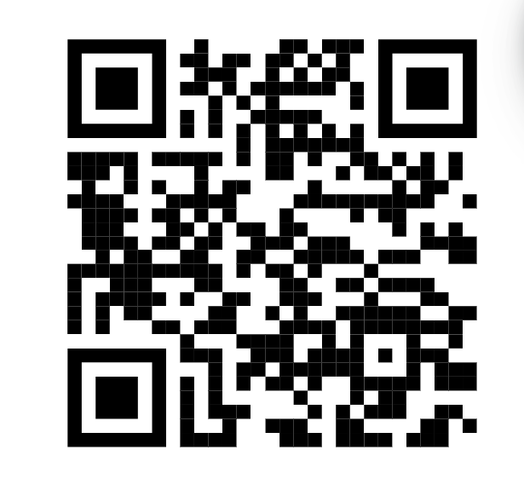
HTTPS://FORMS.OFFICE.COM/R/WNATDHSDWU
Quiz

Slide 33
REFERENCES
Interaction Design 5th Edition 2019, Chapter 1-2
https://www.interaction-design.org/literature/article/bad-design-vs-good-design-5-examples-we-can-learn-frombad-design-vs-good-design-5-examples-we-can-learn-from-130706
https://www.interaction-design.org/literature/article/what-is-the-difference-between-interaction-design-and-ux-design
https://www.youtube.com/watch?v=FyBOdcMIwM0

